Slide 1
Lesson 12 – Homework review

Slide 2


Do not make cast without verification

Slide 3


@Key,@Shift – target should be FIELD

Slide 4
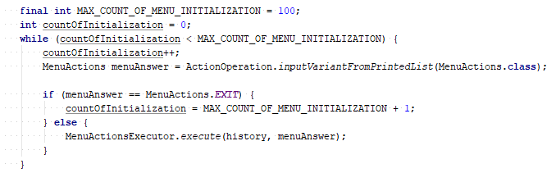
Use flag to stop app instead of counter

Slide 5
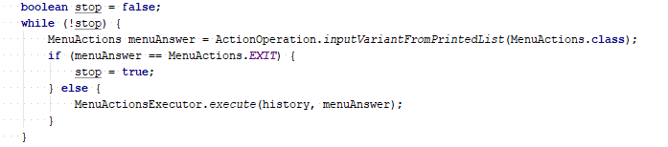
Use flag to stop app instead of counter

Slide 6
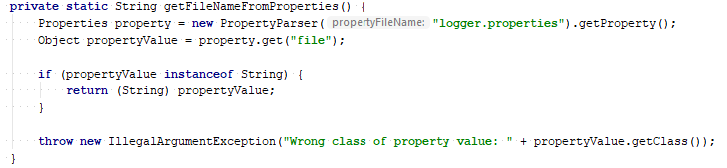

Use proper methods provided by API

Slide 7
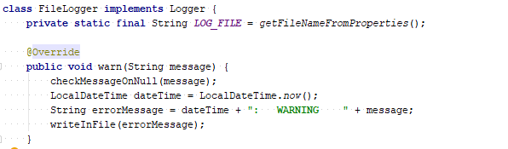
Do not read properties inside classes

Slide 8
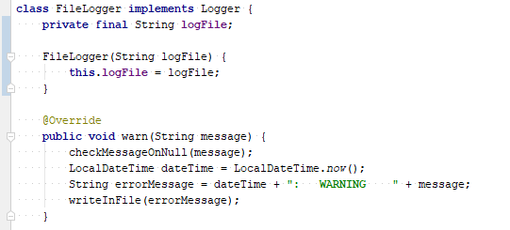
Do not read properties inside classes

Slide 9
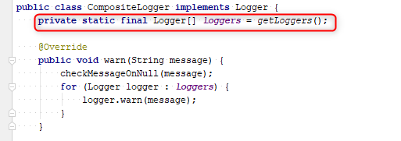
Do not use static loggers inside another

Slide 10
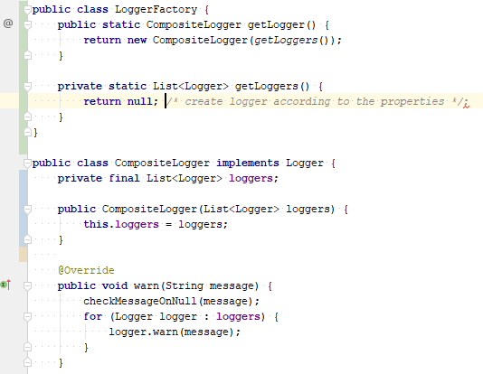
Do not use static loggers inside another

Slide 11
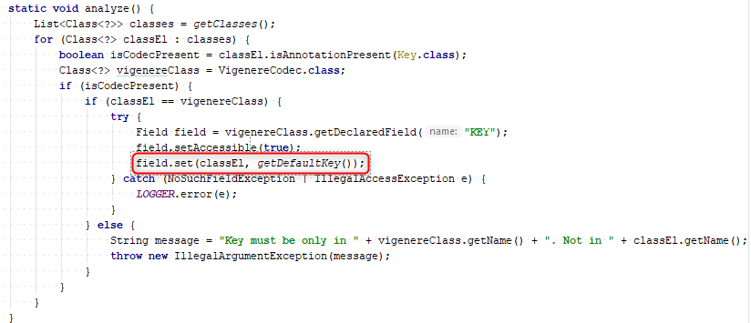
Set value for instance field

Slide 12
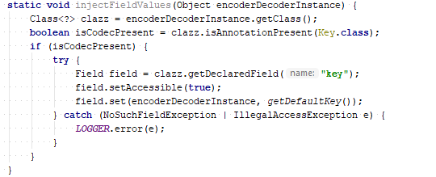
Set value for instance field

Slide 13
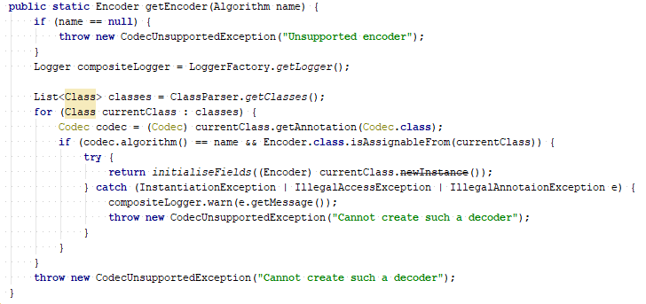
Do not use raw types and deprecated method

Slide 14
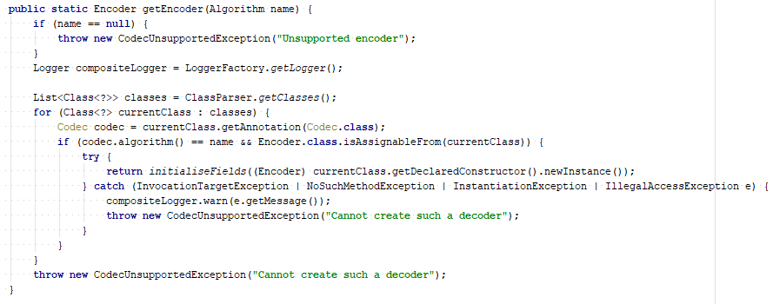
Do not use raw types and deprecated method

Slide 15
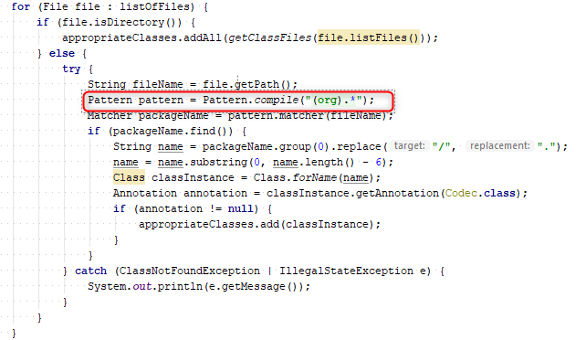
Do not compile pattern in loop on each iter

Slide 16
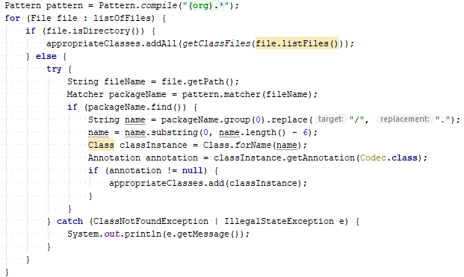
Do not compile pattern in loop on each iter

Slide 17
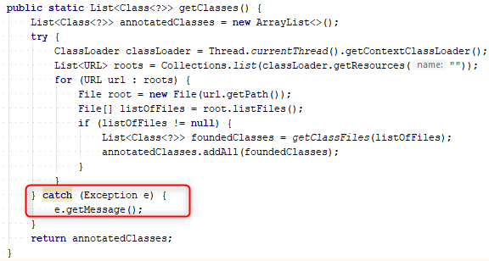
Handle exceptions correctly

Slide 18
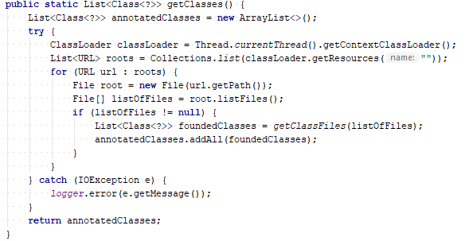
Handle exceptions correctly

Slide 19
Apply recommendations from personal feedbacks before starting next homework

